Slide 1
Inha University in Tashkent
Theme 8. Philosophical Laws, Categories and Methods

Slide 2
Outline:
Philosophical Laws
Categories of Philosophy
Philosophical Methods

Slide 3
Debate on the Objects and Events
The debate on the state of the objects and events in the universe:
1) as well as movement, transformation, development;
2) the changing character from one state to another;
3) the interrelations and interactions between them.
It is difficult to have a scientific understanding:
1) of the universe and its development;
2) the source of development, the driving forces;
3) and above all, the prediction on the future.
All the events around us, from the smallest particles to the Earth, the Sun, to the universe, as well as human beings are always in motion, change, and development. They have endless interconnection, interaction and relationship. The movements and changes don’t occur randomly or by chance.

Slide 4
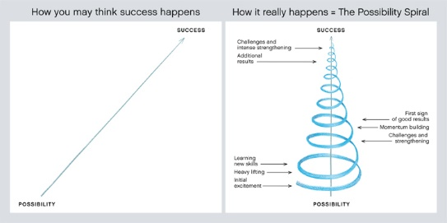
What is the motion?
The movement is a change in the universe.
The concept of development represents the movement from the bottom to the top or the progressive movement from the simple to the complex.
But this process can be:
1) a linear,
2) sometimes slowly expanding spiral motion.

Slide 5

The Laws of Philosophy
The existence of the world is the eternal repetition of internal and external changes. If these repetitions of objects and events are tended to preserve their essence and characteristics it leads to the formation of their certain rule and law.
First of all, it is necessary to say that everything in the universe - the development of nature, society and humanity - is based on certain its rules. The main task of science (social, natural, etc.) is to conduct research in every field, to study and explain the discovery or disclosure of laws.
The law represents relatively stable, recurring relationships, and it does not portray the changeable character.
For example, as usual the spring comes after the winter according to the law of season. It is impossible to imagine that the spring comes after the summer.

Slide 6

The Categories of Philosophy
The category (from Greek, "accusation, utterance, attribute") is an extremely general concept expressing the most essential relations of reality.
The study of categories consists in the definition of the most fundamental and broad classes of entities.
The term “category” was firstly used by Aristotle. In the ancient Greek language, the term used to mean "accusation".
The original meaning of the "accusation" was weakened by Aristotle to "affirmation", "utterance". He discussed the philosophical categories in his famous book – “Organon”.
The Organon is Aristotle’s work on logic that consists of six collections. The first collection was devoted to the Categories.

Slide 7

Aristotle’s Categories
Aristotle applied the term as “affirmation” to the 10 most common characteristics (attributes) of things. These are:
1. Substance (essence)
2. Quantity
3. Quality
4. Relation
5. Place
6. Time
7. Position
8. State
9. Action
10. Affection

Slide 8
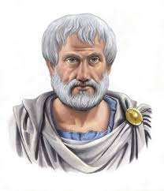
The Legacy of Aristotle on Philosophy
Aristotle systematized the rules and categories of philosophy
He described it and raised philosophy to the level of science for the first time.
Since then, philosophy has become a science that has its own laws, principles, and categorical concepts.
In the East, Farobiy, Beruniy, and Ibn Sina also devoted attention to the issue.
There are concrete (physical objects) and abstract (idea, time) things.

Slide 9
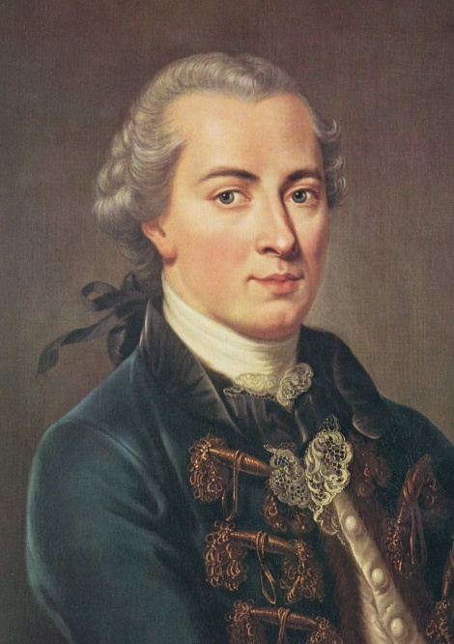
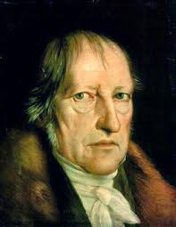
Kant and Hegel’s Views on Categories
In the 17th and 19th centuries, a new era in the analysis of philosophical categories came into existence.
In particular, Immanuel Kant in his work – “Critique of Pure Reason” which was written in 1781 argued that the categories are part of our own mental structure and consist of previous concepts through which we interpret the world around us.
He elaborated four types of categories: quality (reality, negation, limitation), quantity (unity, plurality, totality), relation (substance and feature, reason and movement, interactions), modality (possibility, existence).
Unlike Kant, Hegel described categories as being (sensation, measure), essence (cause and effect), notion (beauty, goodness, truth).

Slide 10
Characteristics of Categories
In summing up, various views on the categories of philosophy, they have the following descriptions as logical concepts:
1) the perception of the universe;
2) a method of cognition that logically generalizes the interconnection and interrelation of things and events (realities);
3) logical concept that changes with the development of things and events;
4) one of the levels of historical-logical knowledge derived from the existence of the universe.
Many scholars conclude that categories are the concepts of the universe, the things and events that are eternal and repetitious in it.

Slide 11

Methods in Philosophy
Method (from the Greek methodos - the way, way of research, teaching, presentation):
- a set of techniques and operations of cognition and practical activity;
- the way to achieve certain results in cognition and practice.
Each sphere of human activity has its own specific method: one can talk about the method of artistic creativity; method of information processing; method of warfare, etc.
Philosophy mainly considers the method of cognition.
Any method is created on the basis of a particular theory and is a necessary condition for research.
The effectiveness of each method is based on its deep meaning and essence, and the fundamentality of the theory.

Slide 12
Dialectic
Dialectic or dialectics (Greek: διαλεκτική, dialektikḗ), is one of the methods in philosophy.
It is a discourse or formal discussion between two or more people holding different points of view about a subject but wishing to establish the truth through reasoned arguments.
Dialectical method is aimed to examine and cognition of philosophical objects. Dialectical method demands the scholars on philosophy to study the objects:
in relation to other objects and to the whole system;
examine the objects within a dynamic, evolutionary environment.
The method is usually contrasted with metaphysical method, which study the objects in a separated, isolated and static environment.
The word "dialectic" was first used by Socrates (469-399 AD). The term "dialectic" comes from ancient Greek philosophy and became popular thanks to Plato's "Dialogues“.

Slide 13
Metaphysics
Metaphysics (Greek, "after physics") is universal method, such as dialectics.
This word was introduced in the first century BC by the student of Aristotle, the interpreter of his poems – Andronicus of Rhodes.
The distinctive feature of metaphysics method is:
1) the lack of a comprehensive system approach to the universe;
2) the denial of interconnection and development between things and realities.
This method is related to the systematic study of the stability of the subjects, changes in them, the definition of sources and mechanisms of development.

Slide 14
Sophism as a Method in Philosophy
Sophism (from the Greek - the ability to cunningly debate) is:
1) the philosophical tradition in ancient Greece, created by the Sophists
2) Reasoning (conclusion, proof), based on a deliberate violation of laws and principles of formal logic, on the use of false arguments and arguments given for the right.
Sophism as a method of training was introduced by the ancient Greek sophists in Greek polices of approximately in the 5th century.
Sophists were professional teachers who taught noble youth on oratorical skills and the art of public debate in order to prepare for a political or other career.
As a philosophical method sophism is a voluntary choice of thought based on controversial ideas that can be used to prove anything.

Slide 15
Thank you for your attention!

